Slide 1

K.S. SCHOOL OF ENGINEERING AND MANAGEMENT DEPARTMENT OF ELECTRONICS AND COMMUNICATION ENGINEERING Mini Project Presentation on Li-fi Based Text Transmission
Project Team
Under the Guidance of
Guide Name
Prof Sanjay B Nayak
Dept of ECE
Abhinandan.S(1KG22EC003)
Darshan.K(1KG22EC027)
Jupalli Kartik(1KG22EC051)
Varun.R(1KG23EC408)

Slide 2
Introduction
Li-Fi, short for Light Fidelity, is a revolutionary technology that utilizes visible light communication (VLC) to transmit data. Unlike Wi-Fi, which relies on radio waves, Li-Fi employs light waves to transmit data. This innovative approach offers several advantages, including high data rates, enhanced security, and interference-free operation.
Li-Fi, short for Light Fidelity, is a wireless communication technology that uses visible light to transmit data.

Slide 3
How Li-Fi Works ?
Li-Fi systems use light-emitting diodes (LEDs) to transmit data. These LEDs can be rapidly modulated to encode information. A photodetector, such as a photodiode, receives the modulated light and converts it back into electrical signals, which are then decoded to extract the transmitted data

Slide 4
Literature Review
Li-Fi (Light Fidelity) is an innovative wireless communication technology that utilizes visible light to transmit data, offering an alternative to conventional Wi-Fi.
Several studies have explored the potential of Li-Fi for efficient and high-speed text communication, demonstrating speeds that can far exceed those of traditional Wi-Fi, with some research showing data rates up to 10 Gbps.
Li-Fi's use in text transmission offers distinct advantages, such as the ability to operate in environments sensitive to electromagnetic interference, such as hospitals, aircraft, and industrial settings.
Since visible light cannot penetrate walls, it inherently provides a higher level of security compared to RF communication, making it ideal for confidential data exchange.However, challenges remain in realizing the full potential of Li-Fi for text transmission.

Slide 5
Design Considerations for Li-Fi Text Systems
LED Selection
Photodiode Choice
Choosing high-power LEDs with fast modulation rates is crucial for high-speed transmission.
Sensitive photodiodes are needed to capture the modulated light signals effectively.
Modulation Schemes
Error Correction
Selecting appropriate modulation techniques ensures reliable and efficient data transmission.
Implementing error correction codes is essential to mitigate data corruption during transmission.

Slide 6
Problem Statement
To develop a robust and efficient Li-Fi system that overcomes the limitations of traditional wireless technologies and provides high-speed, secure, and energy-efficient data transmission

Slide 7
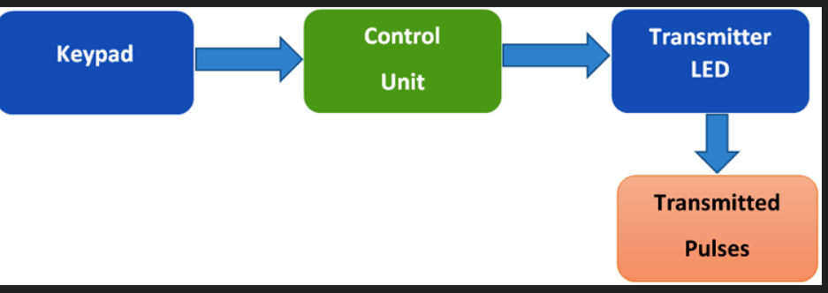
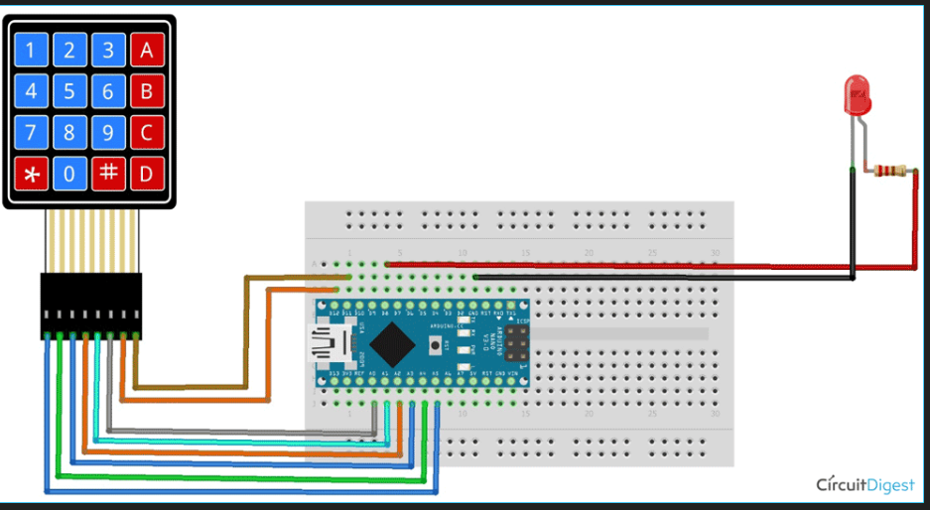
Block Diagram/Methodology
The Transmitter Side Block diagram with Working Methodology

Slide 8

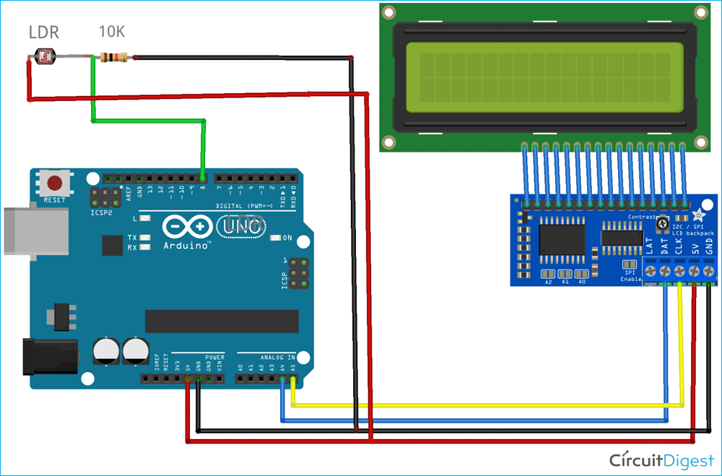
The receiver side block diagram with working methodology

Slide 9
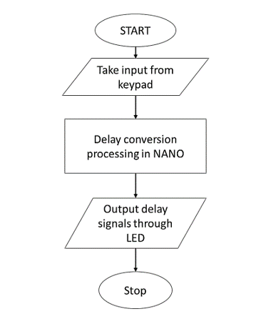
Flow Chart of Transmitter Part :
Flow Chart of Transmitter

Slide 10
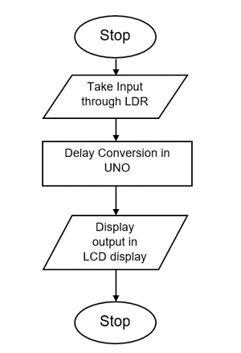
Flow Chart of Receiver Part :
Flow Chart of Receiver

Slide 11
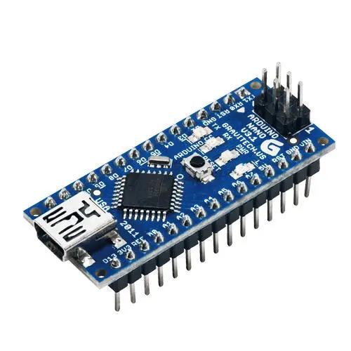
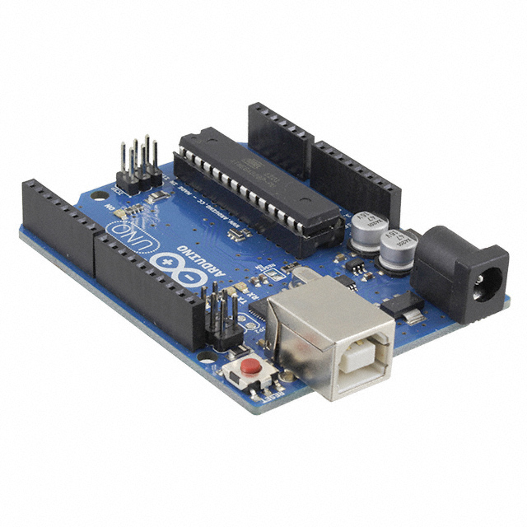
Interfacing
1.1 Arduino Nano(Transmitter Side)
1.2 Arduino UNO(Receiver Side)

Slide 12
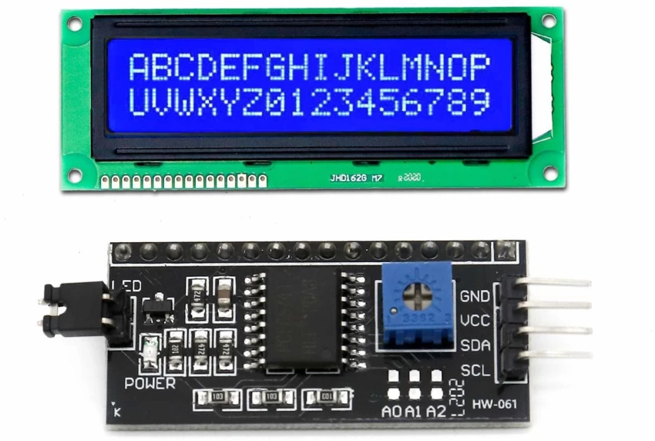
1.3 LCD Display with 12C connecting the display

Slide 13
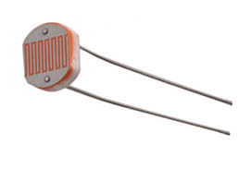
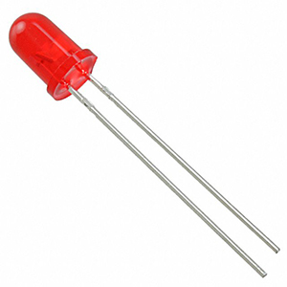
1.4 LDR Sensor
1.5 LED

Slide 14
Hardware and Software Component List
Sl.no | components | quantity
1 | Arduino uno | 1
2 | Lcd display | 1
3 | Breadboard | 2
4 | LDR sensor | 1
5 | Resistor (ohm) | 1
6 | Arduino nano | 1
7 | Led | 1
8 | Connecting wires | -
Arduino uno interfacing software Version-2.3.3
Table 1.2 software code
Table 1.1 hardware component

Slide 15
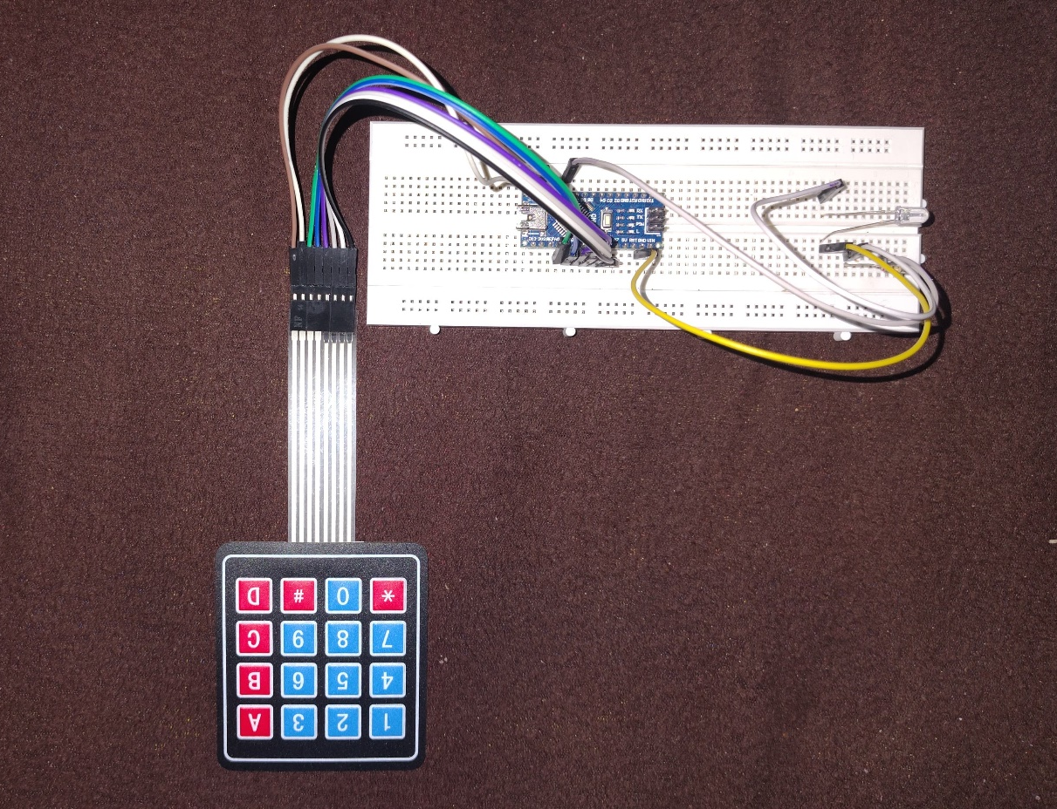
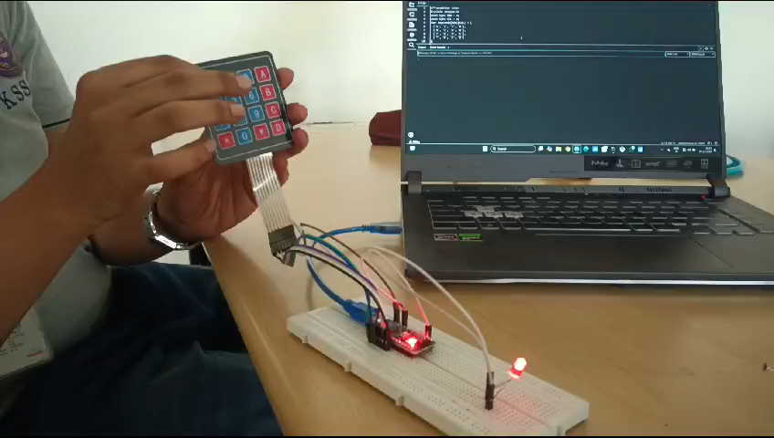
The practical Implementation of Transmitter

Slide 16
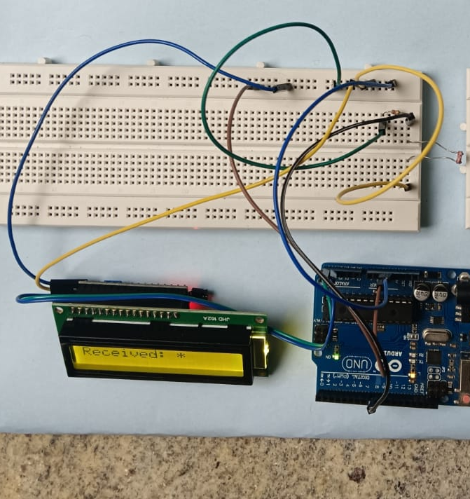
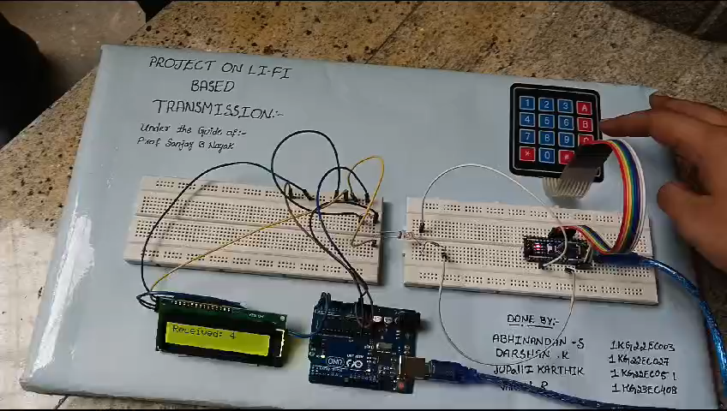
The practical Implementation of Receiver

Slide 17
Challenges and Limitations of Li-Fi Text Transmission
1
Range Limitation
Li-Fi's transmission range is limited by the line-of-sight requirement.
2
Cost
Li-Fi infrastructure and devices can be more expensive than traditional Wi-Fi systems.
Interference
3
External light sources can interfere with Li-Fi signals, affecting transmission quality.
Power Consumption
4
Li-Fi technology can require higher power consumption compared to Wi-Fi.

Slide 18
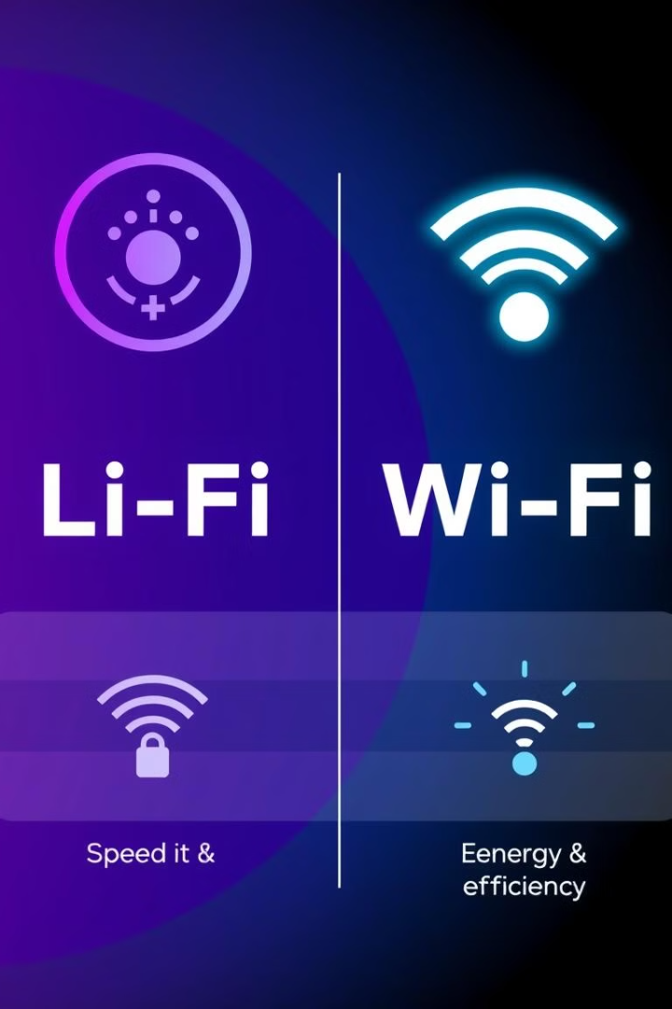
Advantages
High speed data transfer
Lifi is more secure than Wifi
Can be used in sensitive areas
Reduces electromagnetic radiation
Can be used in under water
Low cost
Environmentally friendly

Slide 19
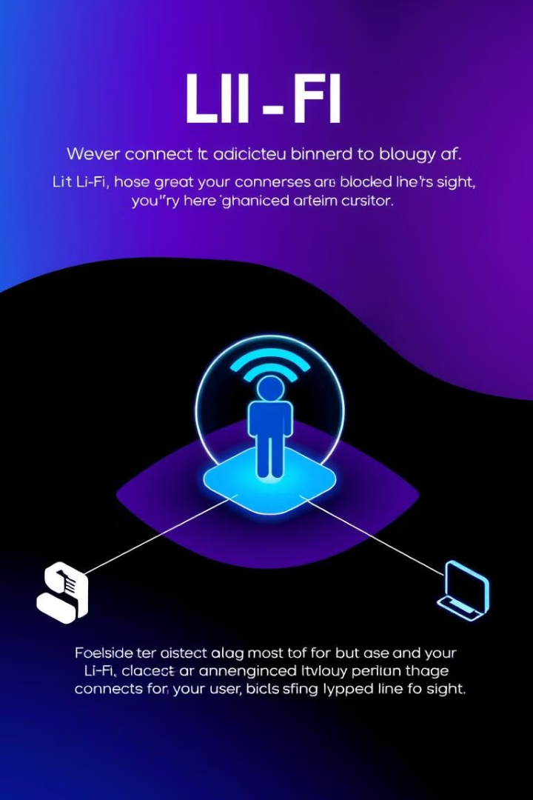
Disadvantages
Short range
Requires direct line of sight
Difficult to use outdoors
Reduced mobility
Interference from Light Sources
Limited Availability

Slide 20




Practical Applications and Use Cases
Industrial Automation
Healthcare
Li-Fi enables seamless data transfer in noisy industrial environments, improving efficiency.
Secure and high-speed Li-Fi networks can support real-time medical data transmission.
Office Environments
Museums and Galleries
Li-Fi offers a safe and high-bandwidth solution for data transfer and collaboration.
Li-Fi can enhance visitor experience by providing interactive content and information.

Slide 21
Future Developments
1
Increased Bandwidth
Future advancements in Li-Fi technology will enable even higher data rates.
2
Wider Adoption
As Li-Fi becomes more cost-effective, it will find broader applications across industries.
3
Integration with IoT
Li-Fi will play a crucial role in connecting and managing devices in the Internet of Things.

Slide 22
References
1. IEEE Xplore Digital Library:
"A Review of LiFi Technology“
Li-Fi Technology: Bridging the Digital Divide through Light"
"Enhancing Healthcare with Li-Fi Technology
2. Google scholar:
Haas H, Yin L, Wang Y, Chen C. What is LiFi? J Light Technol. 2016;34:1533–44.
Kahn JM, Barry JR. Wireless Infrared Communications. Proceedings of the IEEE. 1997;85:265–98
Mesleh R, Elgala H, Hammouda M, Stefan I, Haas H. Optical spatial modulation. IEEE/OSA J Opt Commun Nedw. 2011;3:1–4
Afgani MZ, Haas H, Elgala H, Knipp D Visible light communication using OFDM. 2nd Int Conf Testbeds Res Infrastructures Dev Networks Communities, 2006 TRIDENTCOM 2006. 2006;129–34
Haas H. Wireless data from every light bulb. TED Website.

Slide 23

Results: Final prototype

Slide 24


